Slide 1
Scaling I: Payment Channels, State Channels
CS251 Fall 2021
(cs251.stanford.edu)
Benedikt Bünz

Slide 2
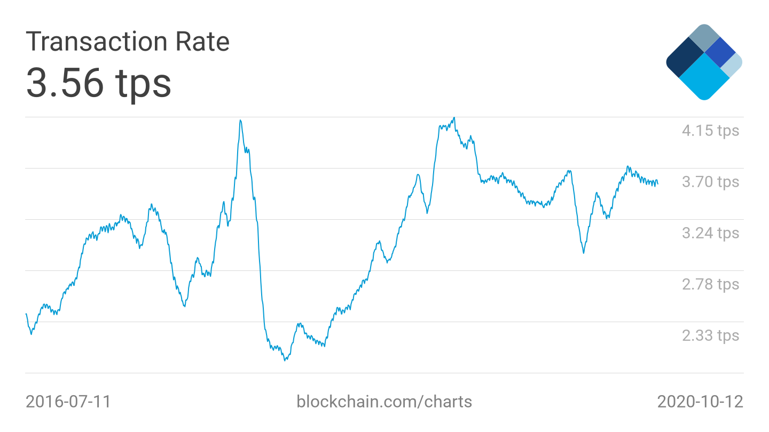
Bitcoin Throughput

Slide 3
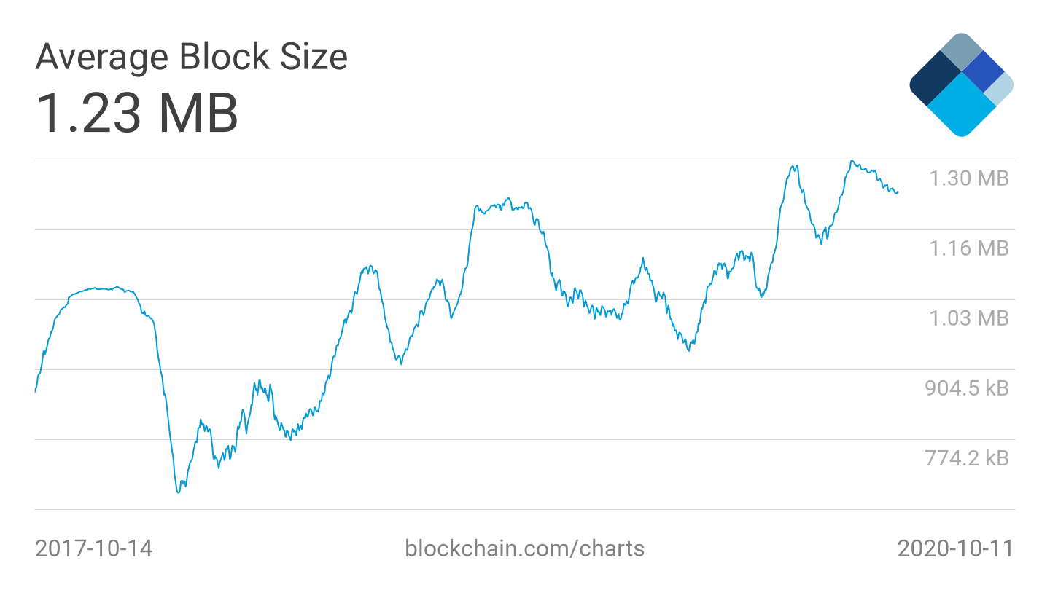
Block Size
1 MB per Block
250 byte
4000 tx/block
Max: 6.7 tx/s

Slide 4
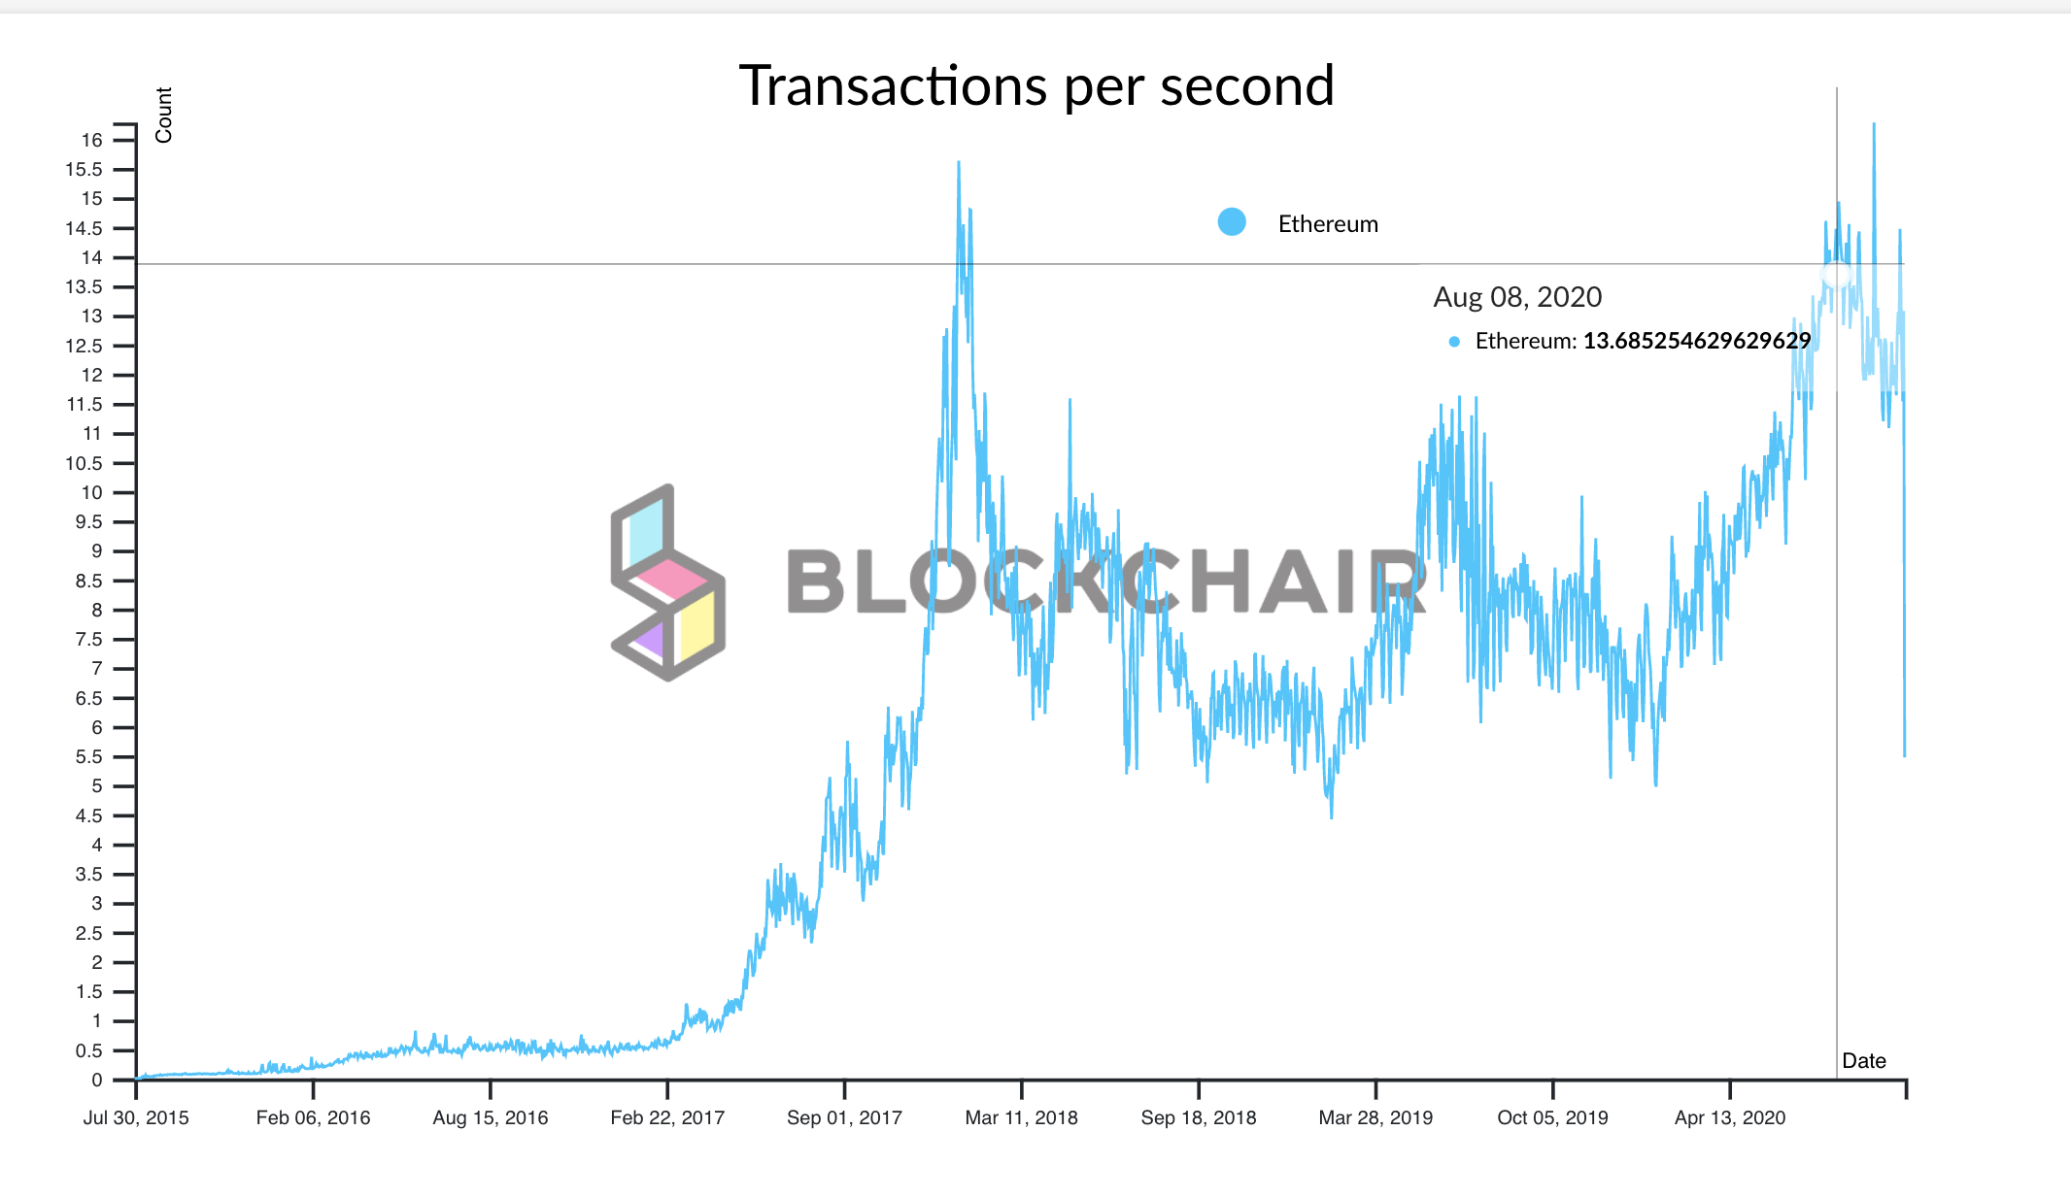
Ethereum Throughput
TX: 21k Gas
12.5M Gas per block
600tx/block
1 Block/15s
Max 40tx/s

Slide 5

Visa Throughput
Visa ~2000tx/s
Up to 65000tx/s (Christmas shopping season)

Slide 6
Raising Blocksize/Gas limit
TX/s directly dependent on blocksize.
Why not raise it?
Network delay/Consensus security is dependent on block size
Additional issue: Latency (delay till TX confirmation)

Slide 7

Idea: Increase #tx without increasing data
What if we don’t record every TX on the chain
Only record settlements
Use Blockchain to solve disputes
Potential to scale transactions especially if everything goes well
Get Blockchain security if things go bad
Blockchain Ledger

Slide 8
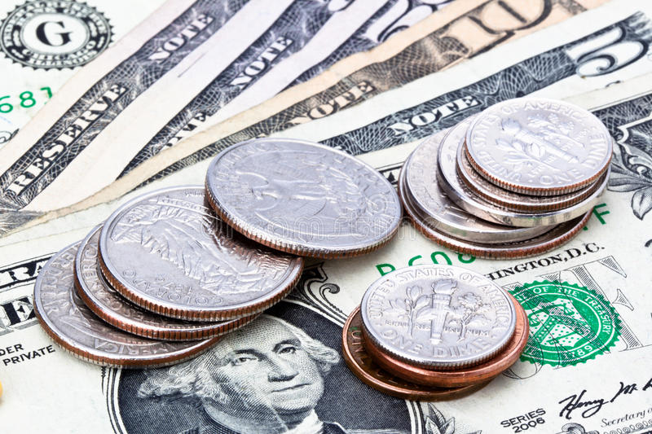
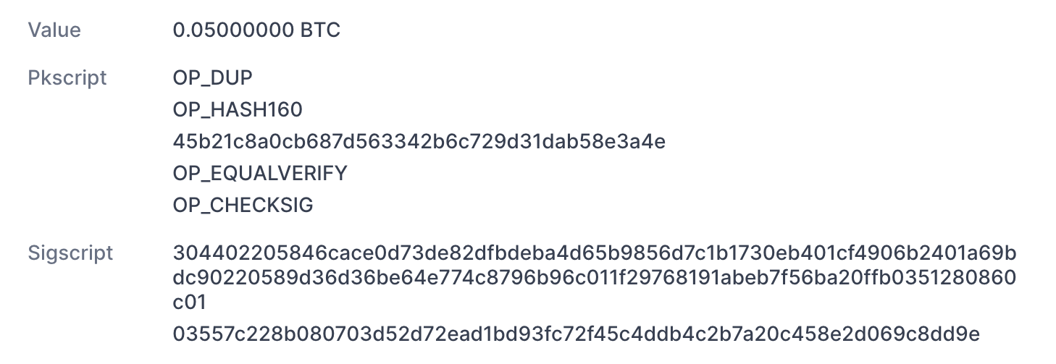
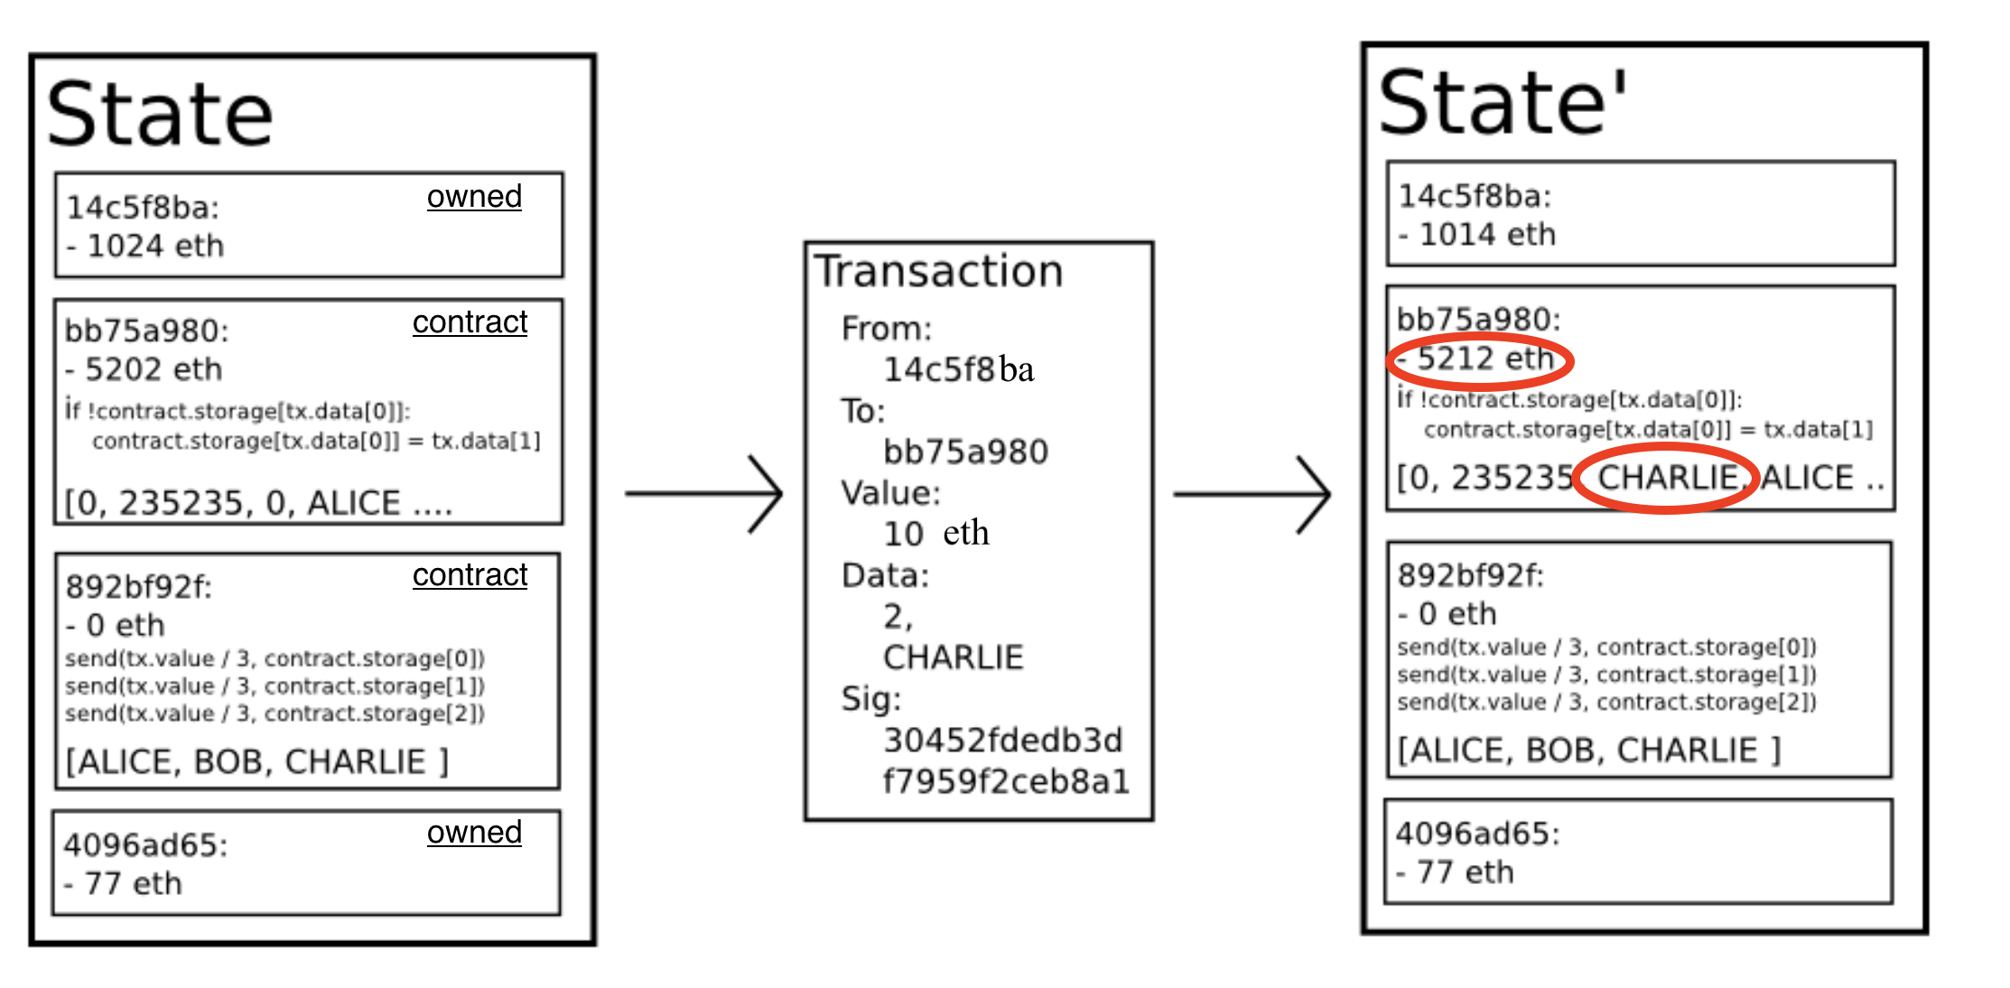
Recap UTXO vs Account
UTXOs +SCRIPTs
(Bitcoin)
Accounts +Smart Contracts (Ethereum)

Slide 9
Payment Channels
Tx1: 0.01 BTC
Tx2: 0.01 BTC
Tx3: 0.01 BTC
Settlement Tx: 0.03BTC
☕️
☕️
☕️

Slide 10
Unidirectional Payment Channel
UTXO A:
1 BTC
Bob does not publish
Publish TX3 on Blockchain
TX1: 0.99 to Alice/0.01 to Bob from UTXO A
Alice
TX2: 0.98 to Alice/0.02 to Bob from UTXO A
Alice
TX3: 0.97 to Alice/0.03 to Bob from UTXO A
Alice

Slide 11
Unidirectional Payment Channel
UTXO A:
1 BTC
Bob does not publish
Attack: Alice double spends UTXO A
Publish TX3 on Blockchain
TX1: 0.99 to Alice/0.01 to Bob from UTXO A
Alice
TX2: 0.98 to Alice/0.02 to Bob from UTXO A
Alice
TX3: 0.97 to Alice/0.03 to Bob from UTXO A
Alice

Slide 12
Unidirectional Payment Channel
UTXO A:
1 BTC
2-2 Multisig Account AB:
1 BTC
Attack:
Bob never signs
Publish TX3 on Blockchain
TX1: 0.99 to Alice/0.01 to Bob from AB
Alice
TX2: 0.98 to Alice/0.02 to Bob from AB
Alice
TX3: 0.97 to Alice/0.03 to Bob from AB
Alice

Slide 13
Unidirectional Payment Channel
Alice needs a way to ensure refund of funds
Basic idea: If Bob doesn’t publish after some time Alice gets 1 BTC refunded
Refund transaction signed before funding Account AB
UTXO A’:
1 BTC
UTXO A:
1 BTC
2-2 Multisig Account AB:
1 BTC
Timelocked
Alice
Bob
Alice, Bob
Channel TX:
0.9 BTC A’ 0.1 to B
Publish

Slide 14
Unidirectional Payment Channel
UTXO A’:
1 BTC
UTXO A:
1 BTC
2-2 Multisig Account AB:
1 BTC
Timelocked
Alice
Bob
Alice, Bob
Channel TX:
0.9 BTC A’ 0.1 to B
Publish
If Alice and Bob cooperate use multisig, otherwise timelock
In Ethereum implemented as smart contract
Non expiring: Refund TX starts claim period for Bob
Once Alice sent 1 BTC to Bob Channel is ”exhausted”

Slide 15
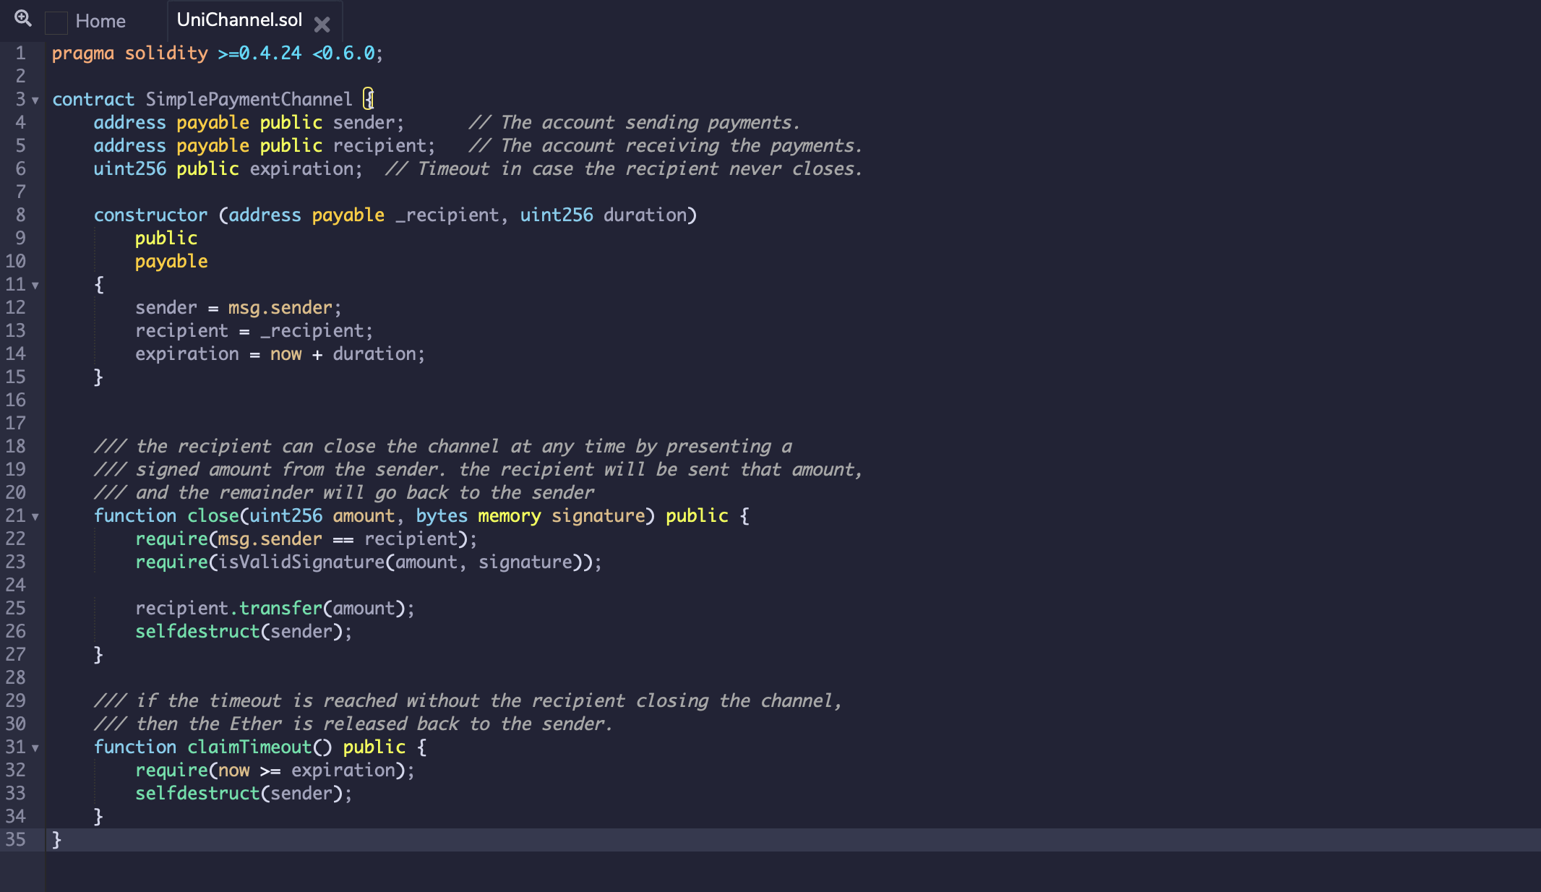
Payment Channel in Solidity

Slide 16
Bidirectional Payment Channel
Alice and Bob want to move funds back and forth
Two Unidirectional Channels?
Not as useful, Channels get exhausted

Slide 17
Bidirectional Payment Channel
Shared Account:
A: 0.5 ETH, B: 0.5 ETH Nonce 0
A: 0.6, Bob: 0.4 Nonce 1
Alice Bob

Slide 18
Bidirectional Payment Channel
Alice and Bob want to move funds back and forth
Shared Account:
A: 0.6 ETH, B: 0.4 ETH Nonce 1
A: 0.3, Bob: 0.7 Nonce 2
Alice Bob

Slide 19
Closing Payment Channel
Shared Account:
A: 0.3 ETH, B: 0.7 ETH Nonce 2
Before funding Alice and Bob get sign initial state
Alice submits balances and signatures to contract.
-> Starts challenge period
If Bob can submit tx with greater nonce: New state is valid.
Instant closing?

Slide 20
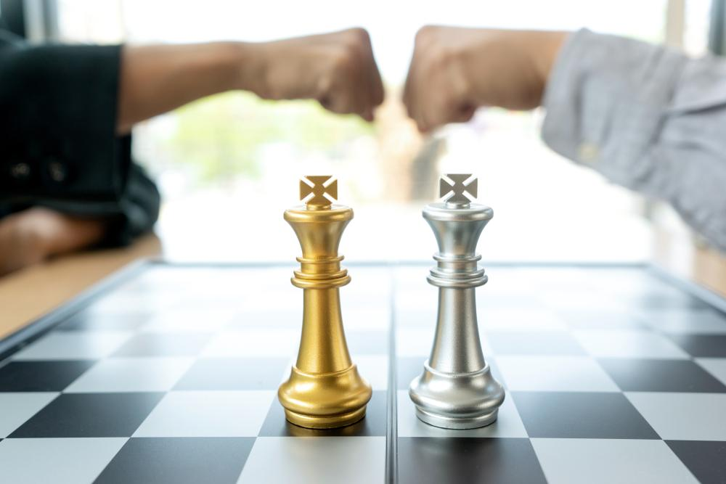
State Channels
Smart contract that implements a game between Alice and Bob
Game has a state

Slide 21
State Channels
Shared Contract:
State: Board state Nonce i
Can be used to move arbitrary 2 party contracts off chain

Slide 22
Payment Chanels with UTXOs
Problem: No state -> Can’t store nonce
Solution:
When updating the channel to Alices benefit,
Alice gets TX that invalidates Bob’s old state

Slide 23
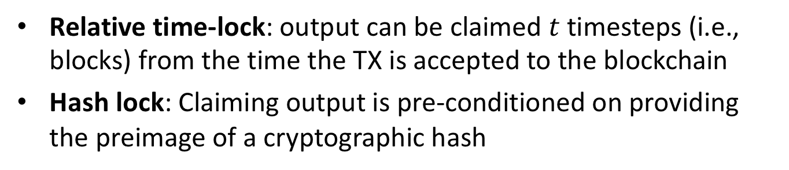
UTXO payment channel concepts
Relative time-lock: output can be claimed $t$timesteps (i.e., blocks) from the time the TX is accepted to the blockchain
Hash lock: Claiming output is pre-conditioned on providing the preimage of a cryptographic hash
Intuition: Both A and B hold TXs they can submit to settle the current split balance. Balance is updated by exchanging new TXs and “invalidating” old. Unilateral settlement is time-locked for one party, allows the other to challenge by providing hash-lock preimage. TXs invalidated by exchanging hash-lock preimages.
Notes:
Relative timelocks were introduced to Bitcoin in BIP 112

Slide 24
UTXO Payment Channel
2-of-2 Multisig Address C:
A: 7BTC, B: 3 BTC
7
3
X=H(x)
Y=H(y)
Random x
Random y
TX1 from C:
Out1: Pay 7 -> A
Out2: Either 3 -> B (7 Day timelock)
Or 3 -> A y s.t. H(y)=Y
Alice
TX2 from C:
Pay 3 -> B
Either 7 -> A (7 Day timelock)
Or 7 -> B given x s.t. H(x)=X
Bob
Notes:
Second condition of out2 is used to invalidate TX

Slide 25
UTXO Payment Channel Update
2-of-2 Multisig Address C:
A: 6 BTC, B: 4 BTC
x
X’=H(x’)
Random x’
TX3 from C:
Out1: Pay 6 -> A
Out2: Either 4 -> B (7 Day timelock)
Or 4 -> A y s.t. H(y)=Y
Alice
TX4 from C:
Pay 4 -> B
Either 6 -> A (7 Day timelock)
Or 6 -> B given x s.t. H(x’)=X’
Bob

Slide 26
Security
Alice has TX2,TX4
Bob has TX1,TX3, x
TX2 from C:
Pay 3 -> B
Either 7 -> A (7 Day timelock)
Or 7 -> B given x s.t. H(x)=X
Bob
TX1 from C:
Pay 7 -> A
Either 3 -> B (7 Day timelock)
Or 3 -> A y s.t. H(y)=Y
Alice
TX4 from C:
Pay 4 -> B
Either 6 -> A (7 Day timelock)
Or 6 -> B given x’ s.t. H(x’)=X’
Bob
TX3 from C:
Pay 6 -> A
Either 4 -> B (7 Day timelock)
Or 4 -> A y s.t. H(y)=Y
Alice

Slide 27
UTXO Payment Channel Update
2-of-2 Multisig Address C:
A: 8 BTC, B: 2 BTC
y
Y’=H(y’)
Random y’
TX5 from C:
Pay 8 -> A
Either 2 -> B (7 Day timelock)
Or 2 -> A y s.t. H(y’)=Y’
Alice
TX6 from C:
Pay 2 -> B
Either 8 -> A (7 Day timelock)
Or 8 -> B given x s.t. H(x’)=X’
Bob

Slide 28
Security
Alice has TX2,TX6, y
Bob has TX3,TX5, x
TX2 from C:
Pay 3 -> B
Either 7 -> A (7 Day timelock)
Or 7 -> B given x s.t. H(x)=X
Bob
TX3 from C:
Pay 6 -> A
Either 4 -> B (7 Day timelock)
Or 4 -> A y s.t. H(y)=Y
Alice
TX6 from C:
Pay 2 -> B
Either 8 -> A (7 Day timelock)
Or 8 -> B given x s.t. H(x’)=X’
Bob
TX5 from C:
Pay 8 -> A
Either 2 -> B (7 Day timelock)
Or 2 -> A y s.t. H(y’)=Y’
Alice

Slide 29
Multi-hop payments
Pay through untrusted intermediary

Slide 30
Multi-hop payments
R=H(r)
Pay 1.01 BTC to B
Hashlocked with R
Timelock to refund
Pay 1 BTC to C
Hashlocked with R
Timelock to refund
Random r
B claims 1.01 BTC with r
C claims 1 BTC with r

Slide 31


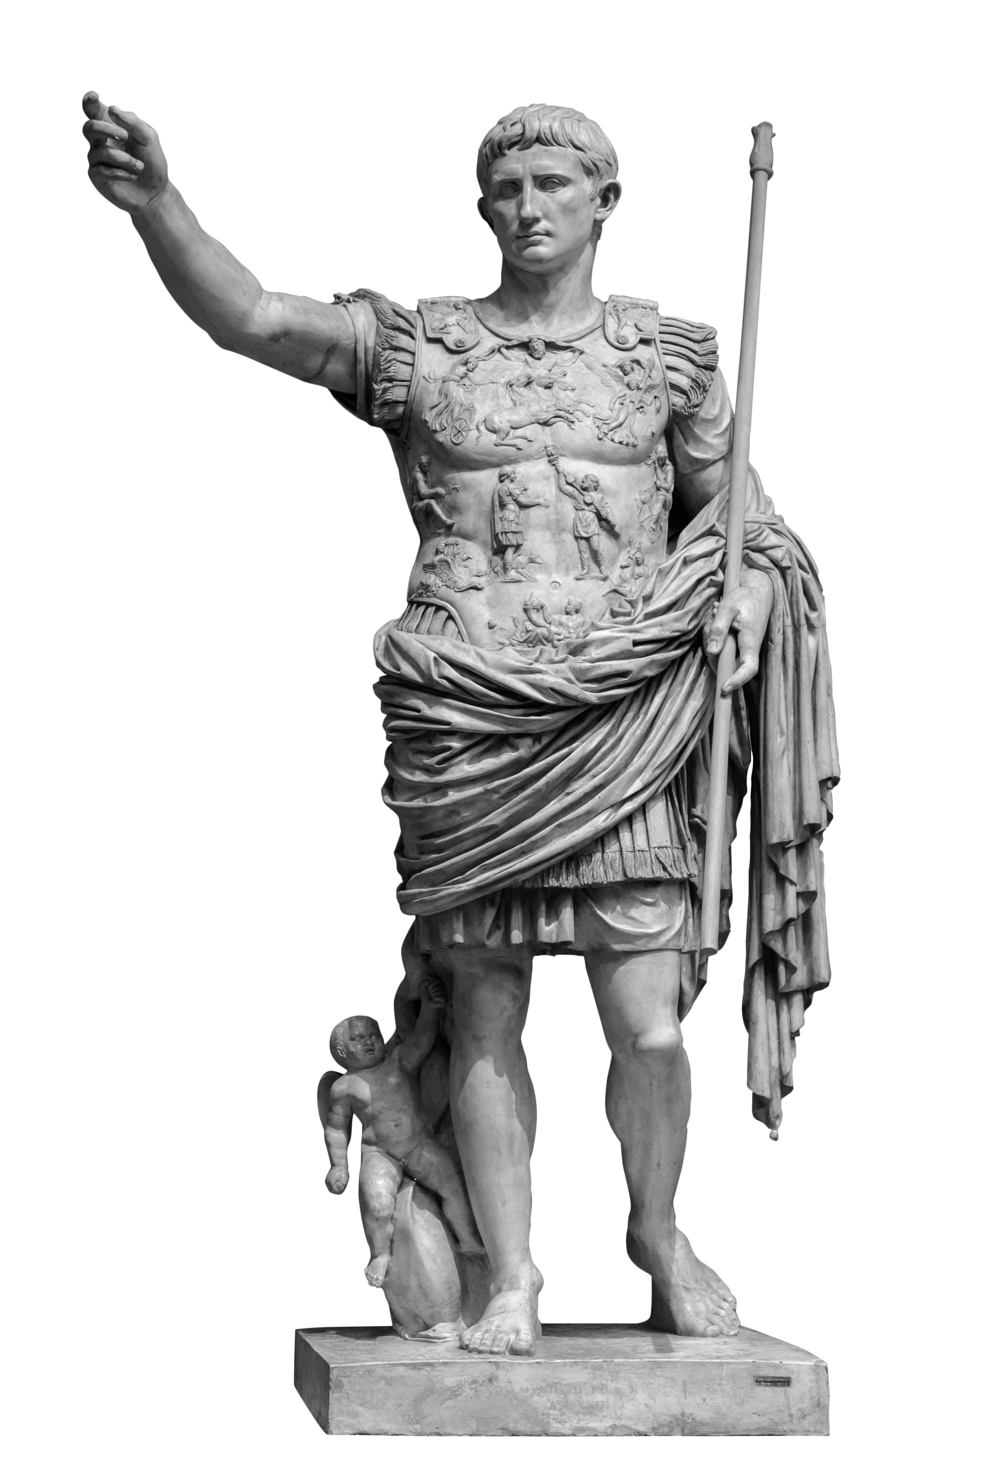
Lightning network
Many extensions possible:
Multi currency hubs
Credit hubs

Slide 32

Watchtowers
Lightning requires nodes to be periodically online to check for claim TX
Watchtowers outsource this task
User gives latest state to watchtower.
Trusted for availability not custodian of funds
Risk of bribing

Slide 33
END OF LECTURE
Next lecture:
Scaling II: Accumulators and Rollup

